Slide 1

Main concepts Classification

Slide 2
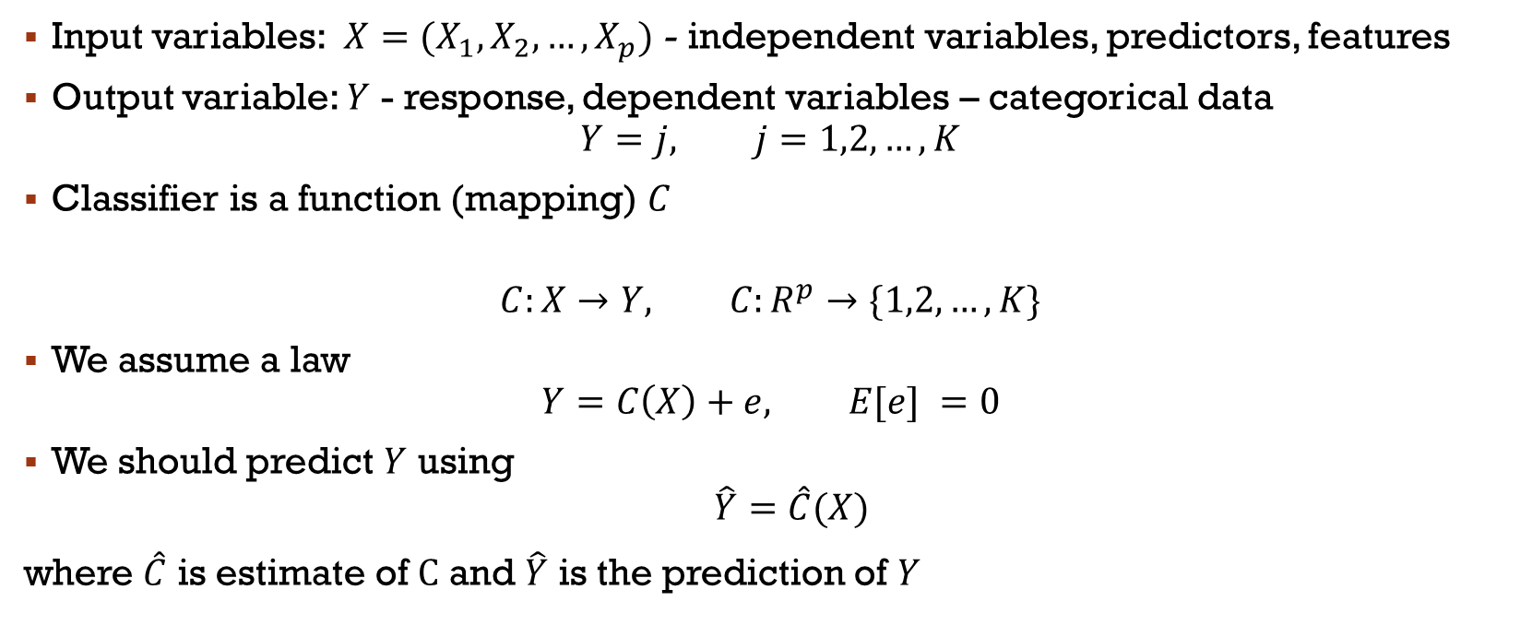
notation
Input variables: $X=(X_{1},X_{2},…,X_{p})$ - independent variables, predictors, features
Output variable: $Y$ - response, dependent variables – categorical data
$$Y=j, j=1,2,…,K$$
Classifier is a function (mapping) $C$
$$C:X→Y, C:R^{p}→\{1,2,…,K\}$$
We assume a law
$$Y=C\left(X\right)+e, E[e] =0$$
We should predict $Y$ using
$\hat{Y}=\hat{C}(X)$
where $\hat{C}$ is estimate of $C$ and $\hat{Y}$ is the prediction of $Y$

Slide 3
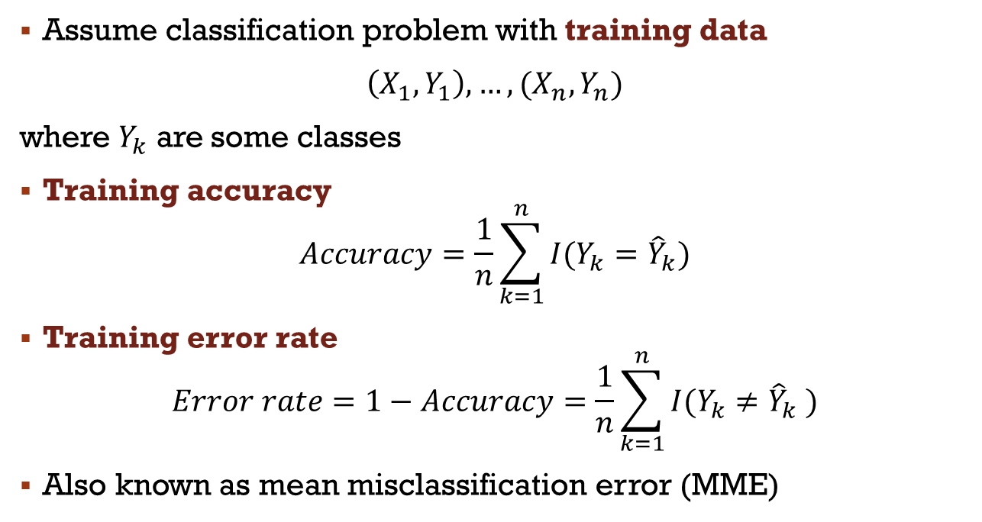
Error rate of Classification
Assume classification problem with training data
$\left(X_{1},Y_{1}\right),…,(X_{n},Y_{n})$
where $Y_{k}$ are some classes
Training accuracy
$$Accuracy=\frac{1}{n}\sum_{k=1}^{n}{I(Y_{k}={\hat{Y}}_{k})}$$
Training error rate
$$Error rate=1−Accuracy=\frac{1}{n}\sum_{k=1}^{n}{I(Y_{k}≠{\hat{Y}}_{k} )}$$
Also known as mean misclassification error (MME)

Slide 4
Test Error rate of Classification
We are most interested in the error rates that result from applying our classifier to test observations that were not used in training
This is known as test error rate
A good classifier is one for which the test error rate is the smallest

Slide 5
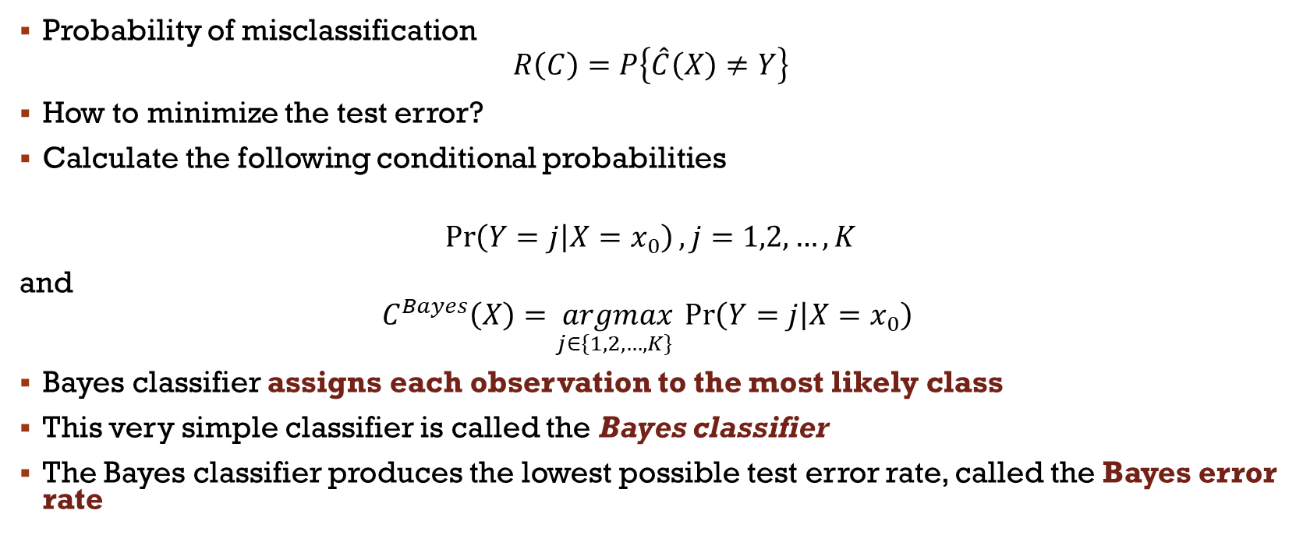
Probability setting - Bayes classifier
Probability of misclassification
$$R\left(C\right)=P\left\{\hat{C}\left(X\right)≠Y\right\}$$
How to minimize the test error?
Calculate the following conditional probabilities
$$\operatorname{Pr}\left(Y=j | X=x_{0}\right), j=1,2,…,K$$
and
$$C^{Bayes}\left(X\right)=\underset{j∈\{1,2,…,K\} }{argmax}{\operatorname{Pr}\left(Y=j | X=x_{0}\right)}$$
Bayes classifier assigns each observation to the most likely class
This very simple classifier is called the Bayes classifier
The Bayes classifier produces the lowest possible test error rate, called the Bayes error rate

Slide 6
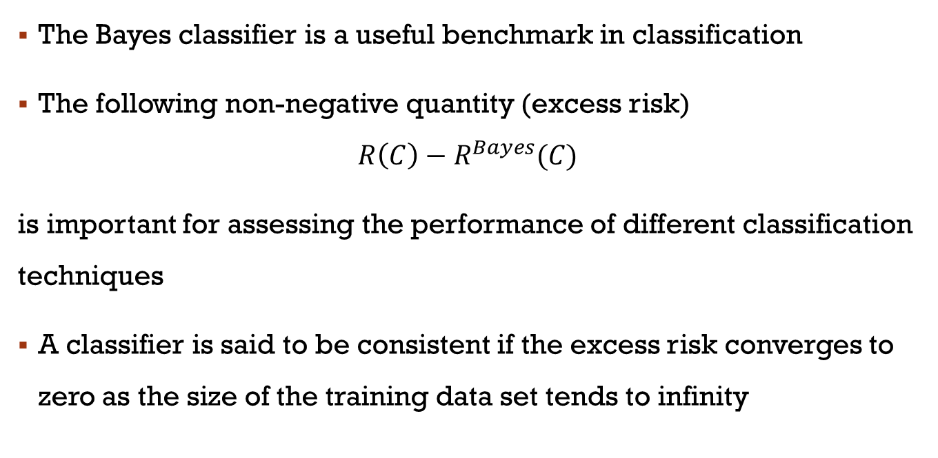
Bayes classifier: continued
The Bayes classifier is a useful benchmark in classification
The following non-negative quantity (excess risk)
$$R\left(C\right)−R^{Bayes}(C)$$
is important for assessing the performance of different classification techniques
A classifier is said to be consistent if the excess risk converges to zero as the size of the training data set tends to infinity

Slide 7
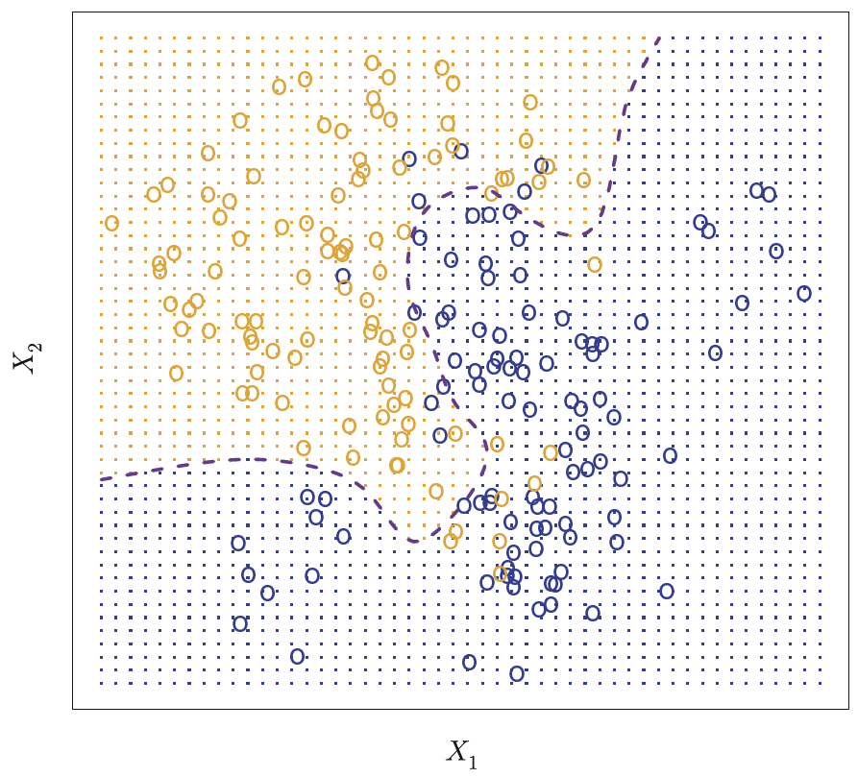
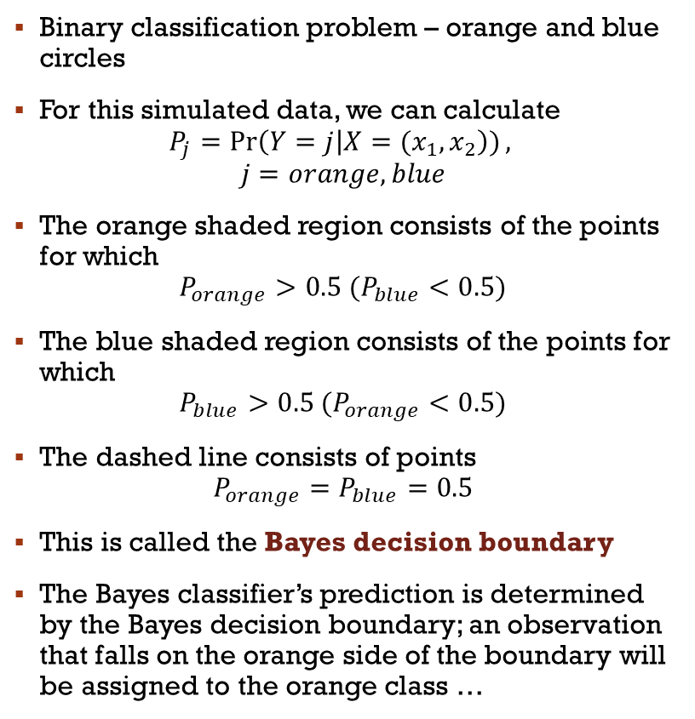
Example
Binary classification problem – orange and blue circles
For this simulated data, we can calculate
$$P_{j}=\operatorname{Pr}\left(Y=j | X={(x}_{1},x_{2}\right)),$$
$$j=orange, blue$$
The orange shaded region consists of the points for which
$$P_{orange}>0.5 (P_{blue}<0.5)$$
The blue shaded region consists of the points for which
$$P_{blue}>0.5 (P_{orange}<0.5)$$
The dashed line consists of points
$$P_{orange}=P_{blue}=0.5$$
This is called the Bayes decision boundary
The Bayes classifier’s prediction is determined by the Bayes decision boundary; an observation that falls on the orange side of the boundary will be assigned to the orange class …

Slide 8

Confusion Matrix for a binary classification
Actual Classes
Positive Class
P
Negative Class
N
$n =N+P$
True Positives
TP
False Positives
FP
Positive Class
Predicted Classes
Negative Class
False Negatives
FN
True Negatives
TN

Slide 9
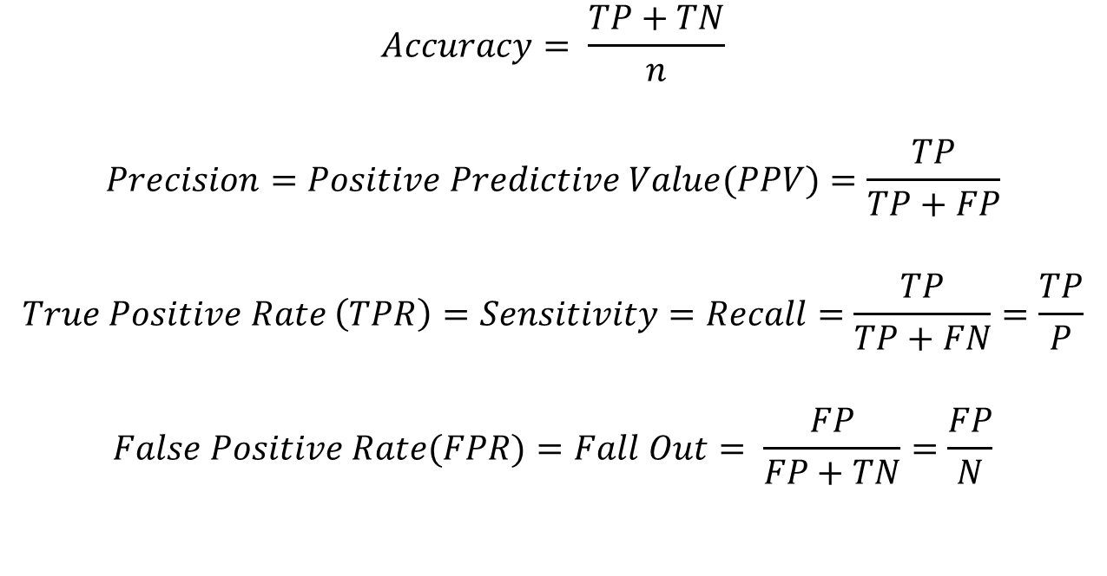
Classification measures
$$Accuracy= \frac{TP+TN}{n}$$
$$Precision=Positive Predictive Value(PPV)=\frac{TP}{TP+FP}$$
$$True Positive Rate \left(TPR\right)=Sensitivity=Recall=\frac{TP}{TP+FN}=\frac{TP}{P}$$
$$False Positive Rate(FPR)=Fall Out= \frac{FP}{FP+TN}=\frac{FP}{N}$$

Slide 10
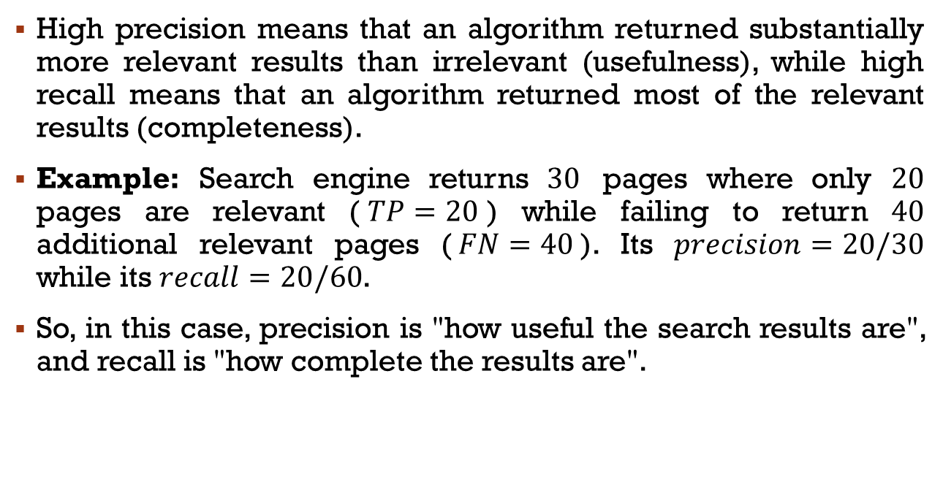
Precision vs Recall
High precision means that an algorithm returned substantially more relevant results than irrelevant (usefulness), while high recall means that an algorithm returned most of the relevant results (completeness).
Example: Search engine returns $30$ pages where only $20$ pages are relevant ($TP=20$) while failing to return $40$ additional relevant pages ($FN=40$). Its $precision=20/30$ while its $recall=20/60$.
So, in this case, precision is "how useful the search results are", and recall is "how complete the results are".

Slide 11
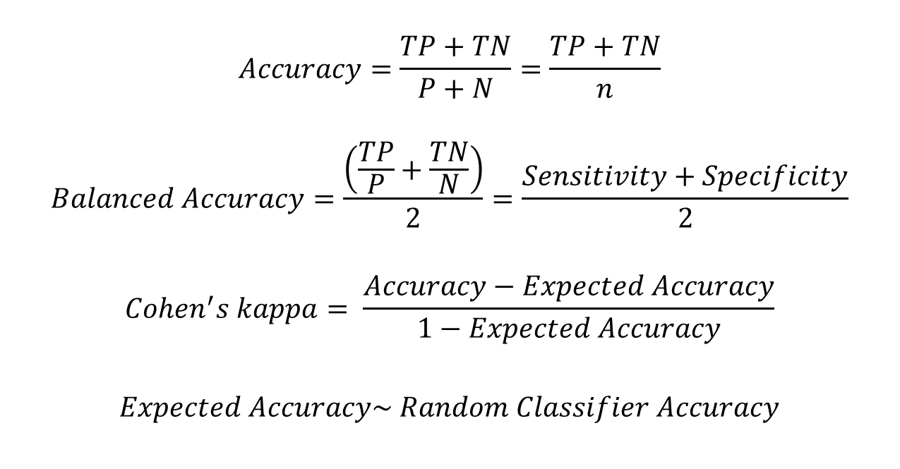
Classification measures
$$Accuracy=\frac{TP+TN}{P+N}=\frac{TP+TN}{n}$$
$$Balanced Accuracy=\frac{\left(\frac{TP}{P}+\frac{TN}{N}\right)}{2}=\frac{Sensitivity+Specificity}{2}$$
$$Cohen^{′}s kappa= \frac{Accuracy−Expected Accuracy}{1−Expected Accuracy}$$
$$Expected Accuracy\sim Random Classifier Accuracy$$

Slide 12

Classification measures
$$Prevalence \sim percentage of each class − Prevalence=\frac{P}{n}$$
$$Detection Prevalence=\frac{TP+FP}{n}$$
$$Detection Rate=\frac{TP}{n}$$
$$F =2\frac{recall ∙precision}{recall+precision}$$

Slide 13





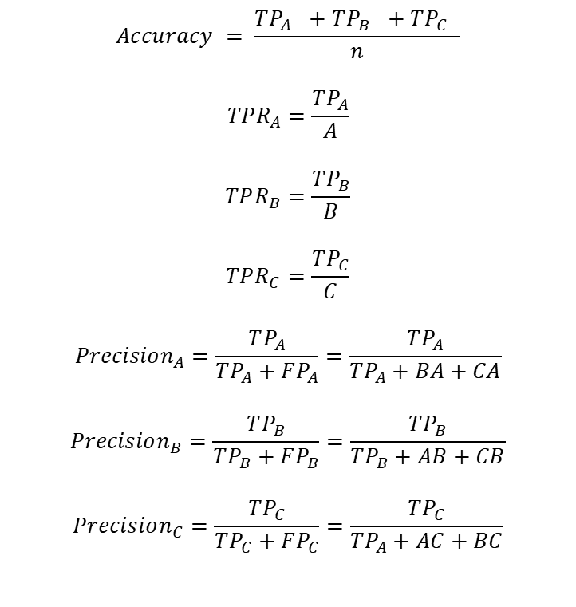






Confusion Matrix for a multiclass classification
$$Accuracy = \frac{TP_{A} +TP_{B} +TP_{C} }{n}$$
$$TPR_{A}=\frac{TP_{A}}{A}$$
$$TPR_{B}=\frac{TP_{B}}{B}$$
$$TPR_{C}=\frac{TP_{C}}{C}$$
$$Precision_{A}=\frac{TP_{A}}{TP_{A}+FP_{A}}=\frac{TP_{A}}{TP_{A}+BA+CA}$$
$$Precision_{B}=\frac{TP_{B}}{TP_{B}+FP_{B}}=\frac{TP_{B}}{TP_{B}+AB+CB}$$
$$Precision_{C}=\frac{TP_{C}}{TP_{C}+FP_{C}}=\frac{TP_{C}}{TP_{A}+AC+BC}$$
Actual Classes
$$n=A+B+C$$
A
B
C
$TP_{A}$
$$BA$$
$$CA$$
C
B
A
Predicted Classes
$$AB$$
$TP_{B}$
$$CB$$
$$AC$$
$$BC$$
$TP_{C}$
$$FPR_{A}= \frac{AB+AC}{B+C}$$
$$FPR_{B}= \frac{BA+BC}{A+C}$$
$$FPR_{C}= =\frac{CA+CB}{A+B}$$

Slide 14
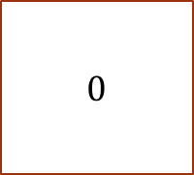
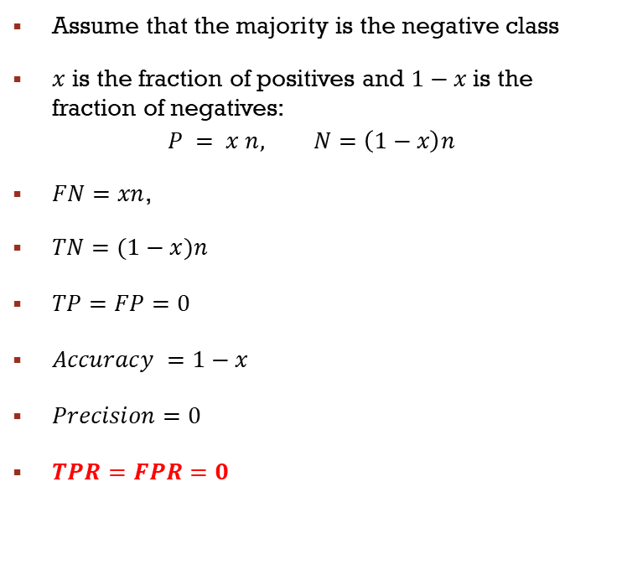



Baseline - Majority class classifier
Actual Class
$\text{Assume} \text{that} \text{the} \text{majority} \text{is} \text{the} \text{negative} \text{class}$
$x$ is the fraction of positives and $1−x$ is the fraction of negatives:
$$P = x n, N=\left(1−x\right)n$$
$FN=xn$,
$TN=(1−x)n$
$TP=FP=0$
$Accuracy =1−x$
$Precision=0$
$TPR=FPR=0$
P
N
n
$0$
$0$
P
Predicted Class
$FN$
$TN$
N

Slide 15
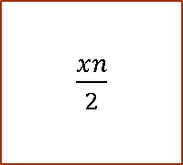
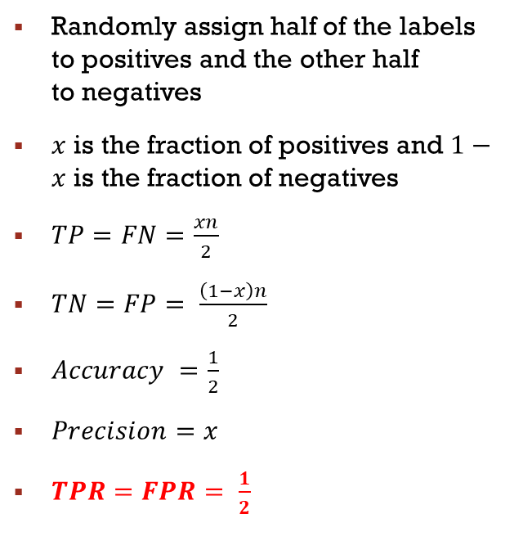
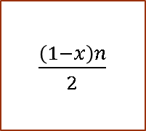
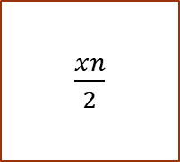

Baseline - Random guess
Actual Class
Randomly assign half of the labels to positives and the other half to negatives
$x$ is the fraction of positives and $1−x$ is the fraction of negatives
$TP=FN=\frac{xn}{2}$
$TN=FP= \frac{\left(1−x\right)n}{2}$
$Accuracy =\frac{1}{2}$
$Precision=x$
$TPR=FPR= \frac{1}{2}$
P
N
n
$\frac{xn}{2}$
$\frac{(1−x)n}{2}$
P
Predicted Class
$\frac{xn}{2}$
$\frac{\left(1−x\right)n}{2}$
N

Slide 16
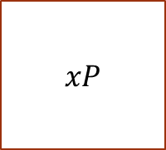
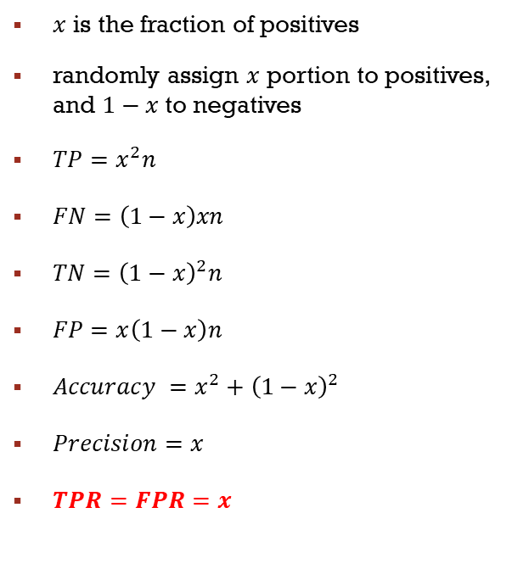
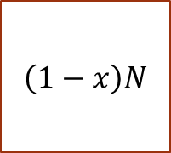
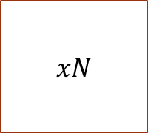
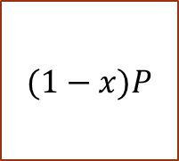
Baseline - weighted Random guess
actual
$x$ is the fraction of positives
randomly assign $x$ portion to positives, and $1−x$ to negatives
$TP=x^{2}n$
$FN=\left(1−x\right)xn$
$TN={\left(1−x\right)}^{2}n$
$FP=x\left(1−x\right)n$
$Accuracy =x^{2}+{\left(1−x\right)}^{2}$
$Precision=x$
$TPR=FPR=x$
P
N
n
$xP$
$(1−x)P$
P
predicted
$xN$
$\left(1−x\right)N$
N

Slide 17
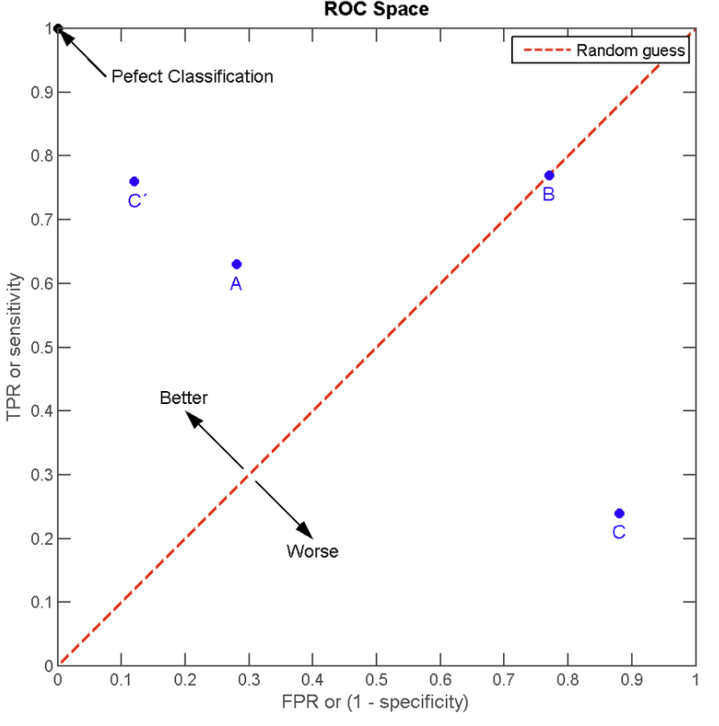
ROC Curve
Perfect Classifier

Slide 18
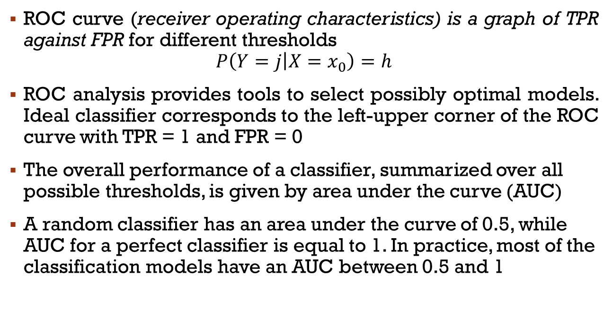
ROC curve
ROC curve (receiver operating characteristics) is a graph of TPR against FPR for different thresholds
$$P\left(Y=j | X=x_{0}\right)=h$$
ROC analysis provides tools to select possibly optimal models. Ideal classifier corresponds to the left-upper corner of the ROC curve with TPR = 1 and FPR = 0
The overall performance of a classifier, summarized over all possible thresholds, is given by area under the curve (AUC)
A random classifier has an area under the curve of 0.5, while AUC for a perfect classifier is equal to 1. In practice, most of the classification models have an AUC between 0.5 and 1

Slide 19
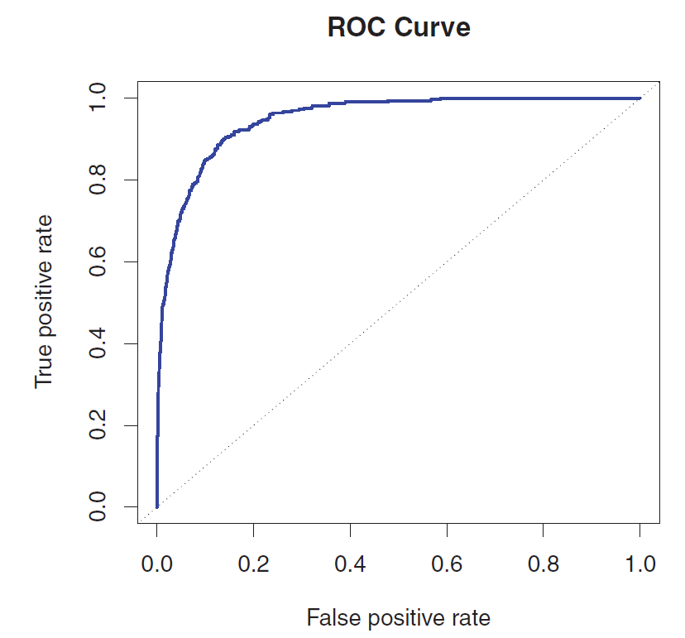
ROC Curve
Random Model

Slide 20
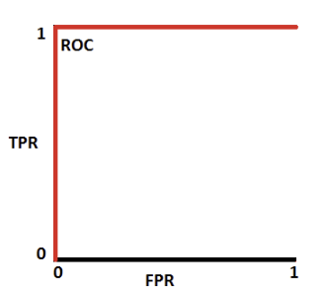
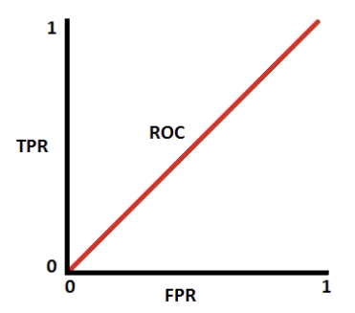
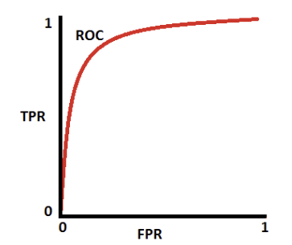



Area Under the curve – (AUC)
$$AUC=1$$
$$AUC=0.5$$
$$AUC=0.7$$

Slide 21
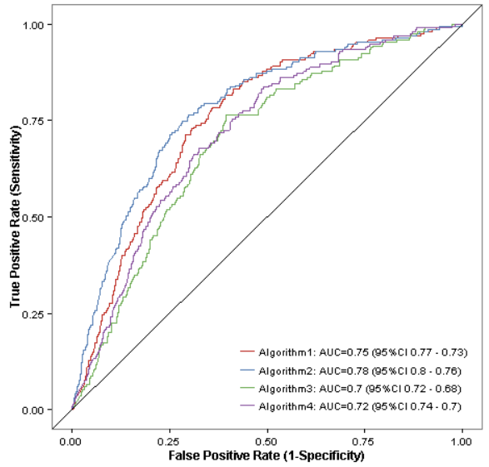
Comparison of Classifiers

Slide 22
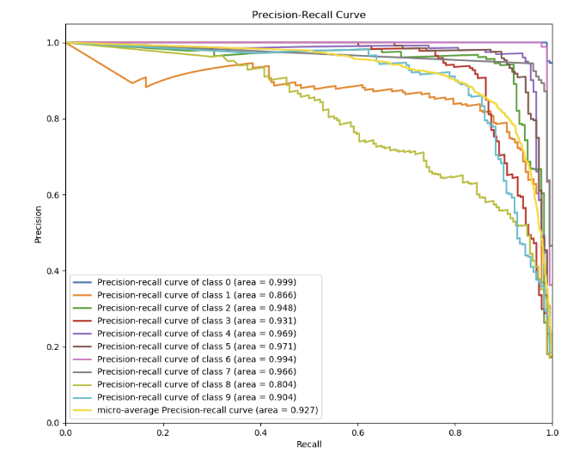
Precision-Recall Curve

Slide 23
Decision boundaries
Any classification algorithm determines decision boundaries which separate identified classes. The classifier will classify all the points on one side of the decision boundary as belonging to one class and all those on the other side as belonging to the other class.

Slide 24
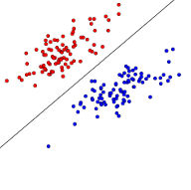
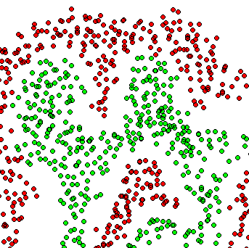
Decision boundaries
Two classes are linearly separable if it is possible perfectly classify them with a linear decision boundary.
Linear classifiers can only draw linear decision boundaries.
Non-linear classifiers have non-linear, and possibly discontinuous decision boundaries.

Slide 25
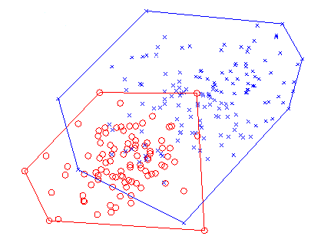
Decision boundaries
Two sets are linearly separable if their convex hulls have no intersection.

